Slide 1
Research designs and methods
A Research Design provides a framework for the collection and analysis of data. Choice of research design reflects decisions about priorities given to the dimensions of the research process.
Key concept 3.1
Page 46
A Research Method is simply a technique for collecting data. Choice of research method reflects decisions about the type of instruments or techniques to be used.
Key concept 3.2
Page 46

Slide 2
Criteria in social research
Reliability – are measures consistent?
Replication/replicability – is study repeatable?
Validity – are conclusions well-founded?
Pages 46, 47

Slide 3
Types of validity
Measurement (or construct) validity – do measures reflect concepts?
Internal validity – are causal relations between variables real?
External validity – can results be generalized beyond the research setting?
Ecological validity – are findings applicable to everyday life?
Pages 47, 48

Slide 4
Alternative criteria in qualitative research
Trustworthiness (Lincoln and Guba (1985) :
    Credibility, parallels internal validity - i.e. how believable are the findings?
    Transferability, parallels external validity - i.e. do the findings apply to other contexts?
    Dependability, parallels reliability - i.e. are the findings likely to apply at other times?
    Confirmability, parallels objectivity - i.e. has the investigator allowed his or her values to intrude to a high degree?
Relevance (Hammersley 1992) :
  Importance of a topic in its field
  Contribution to the literature in that field
Pages 48, 49

Slide 5
Types of research design
1. Experimental
2. Cross-sectional
3. Longitudinal
4. Case study
5. Comparative

Slide 6
Experimental design elements
Random assignment of subjects to experimental and control groups,
Pre-testing of both groups,
Independent variable manipulated; all other variables held constant,
Post-testing of both groups,
Computation and analysis of group differences
Page 50

Slide 7
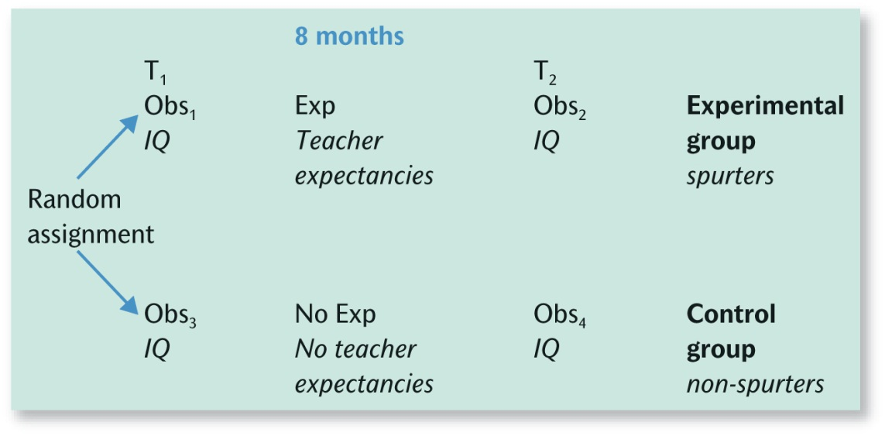
Classical experimental design
Key:
Obs = observation
Exp = experimental treatment (manipulation of the independent variable)
T = timing
Figure 3.1
Page 52

Slide 8
Threats to internal validity
Other (non-experimental) events may have caused the changes observed (‘history’)
Subjects may become sensitized to ‘testing’
People change over time in any event (‘maturation’)
Non-random ‘selection’ could explain differences
‘Ambiguity about the direction of causal influence’ because sometimes the temporal sequence is unclear
Based on Campbell (1957) and
Cook and Campbell (1979)
Pages 52, 53

Slide 9
Threats to external validity
1. Interaction of selection and treatment
2. Interaction of setting and treatment
3. Interaction of history and treatment
4. Interaction effects of pretesting
5. Reactive effects of experimental arrangements
Based on Campbell (1957) and Cook and Campbell (1979)
Pages 53, 54

Slide 10
Cross-sectional design
“A cross-sectional design entails the collection of data on more than one case (usually quite a lot more than one) and at a single point in time in order to collect a body of quantitative or quantifiable data in connection with two or more variables (usually many more than two), which are then examined to detect patterns of association.”
Key concept 3.6
Page 58

Slide 11
…..and survey research?
“Survey research comprises a cross-sectional design in relation to which data are collected predominantly by questionnaire or by structured interview on more than one case (usually quite a lot more than one) and at a single point in time in order to collect a body of quantitative or quantifiable data in connection with two or more variables (usually many more than two), which are then examined to detect patterns of association.”
Key concept 3.7
Page 60

Slide 12
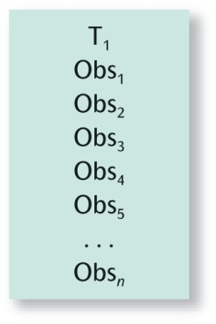
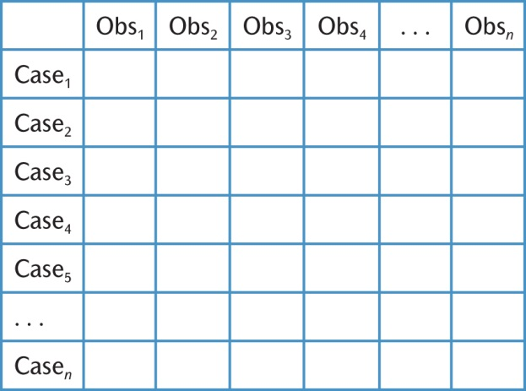
Cross-sectional design
Figure 3.3
Figure 3.2

Slide 13
Evaluating cross-sectional research
Reliability and Measurement Validity are not connected to the design, as such,
Replicability will be high as long as the researcher specifies all the procedures
Internal Validity is weak, because co-relations are much more likely to be found than causality
External Validity will be strong if the sample is truly random
Ecological Validity may be compromised by the instruments used.
Pages 59 - 61

Slide 14
Comparative design
Using the same methods to compare two or more meaningfully contrasting cases
Can be qualitative or quantitative
Often cross-cultural comparisons
  Gallie’s (1978) study of the impact of automation on industrial workers in England and France
Problem of translating research instruments and finding comparable samples
  Includes multiple case studies
Pages 72, 73

Slide 15
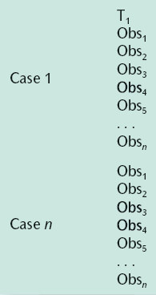
A comparative design
Figure 3.5
Page 72

Slide 16
Evaluating comparative design
The characteristics are identical to those of cross-sectional design, because the comparative design is essentially two or more cross-sectional studies carried out at the same point in time.
Comparing two or more cases can show circumstances in which a particular theory will or will not hold.
Page 74

Slide 17
Longitudinal design
Survey of the same sample on more than one occasion
Typically used to map change in social research
In a panel study (e.g. BHPS – British Household Panel Survey – see Research in focus 3.10 – annual survey since 1991)
Or a cohort study (e.g. NCDS – National Child Development Study – see Research in focus 3.11 –sample of children born in 1958)
Page 64

Slide 18
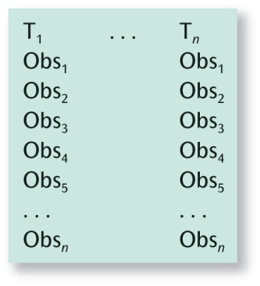
The longitudinal design
Figure 3.4
Page 65

Slide 19
Evaluating longitudinal research
Overall, the characteristics are very similar to cross-sectional research designs.
Special problems:
Attrition, because people die, or move home, or withdraw from the study.
Knowing when is the right time for the next wave of data collection.
The first round may have been badly thought out, which leaves the later rounds in a bit of a mess.
A panel conditioning effect may creep in to the research
Page 65

Slide 20
Case study design
detailed and intensive analysis of one case
e.g. a single community, school, family, person, event, or organization
often involves qualitative research
case is the focus of location/setting just provides a background
types of case: critical, unique, exemplifying, revelatory, longitudinal
e.g. Holdaway (1982, 1983): ethnography of occupational culture in a particular police force
Page 67

Slide 21
Evaluating case-study research
The biggest issue concerns external validity, because it is impossible to generalize the findings.
Many case-writers argue, though, that the point of the research is to examine particulars rather than attempt to generalize.
Cases may be extended longitudinally or through a comparative design.
Pages 62, 63

Slide 22
Bringing research strategy and research design together
Both quantitative and qualitative strategies can be executed through any of the research designs covered in this chapter – although experimentation is rarely used in qualitative research.
Survey research is the most typical form for quantitative strategies
Ethnographic studies are most typical of qualitative strategies.
Table 3.1
Page 76

